Slide 1
Olympic Track and Field Insights
Shailja Mathur, Rodney Daverman, Ricardo Benitez
Peter Drozdzewicz, Nwagbo Chidozie, Matt Kenney
Huss Issa. Donald Yakam, David Wu

Slide 2
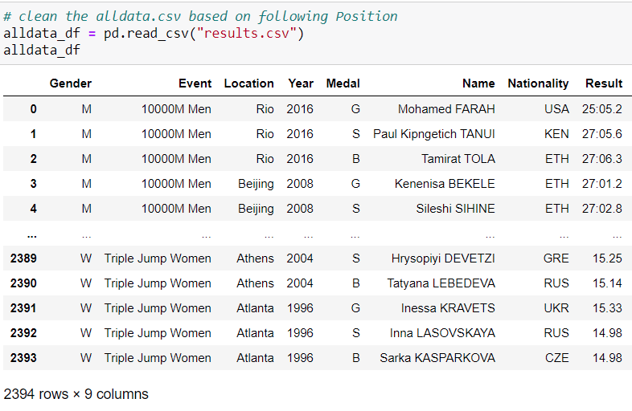
Our Data
For our data, we selected Track and Field data from the Olympic games over the last century.
The following are the columns of relevant data for Track and Field for the Olympics from 1896 to 2016

Slide 3
Project Proposal

Slide 4
Insights

Slide 5
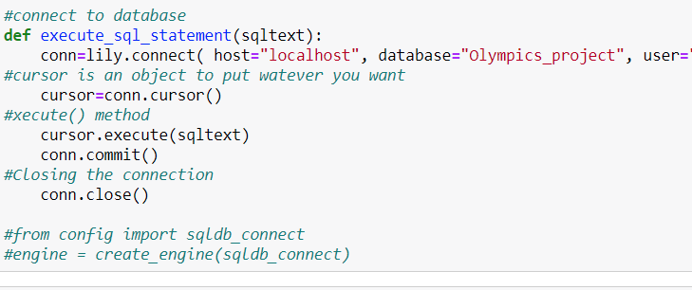
Postgres Server through SqlAlchemy
We imported our Data it into Postgres, SqlAlchemy, to draw various insights

Slide 6
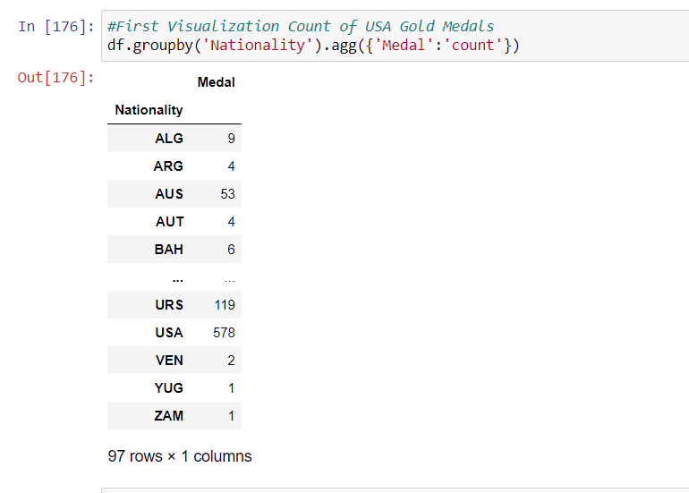
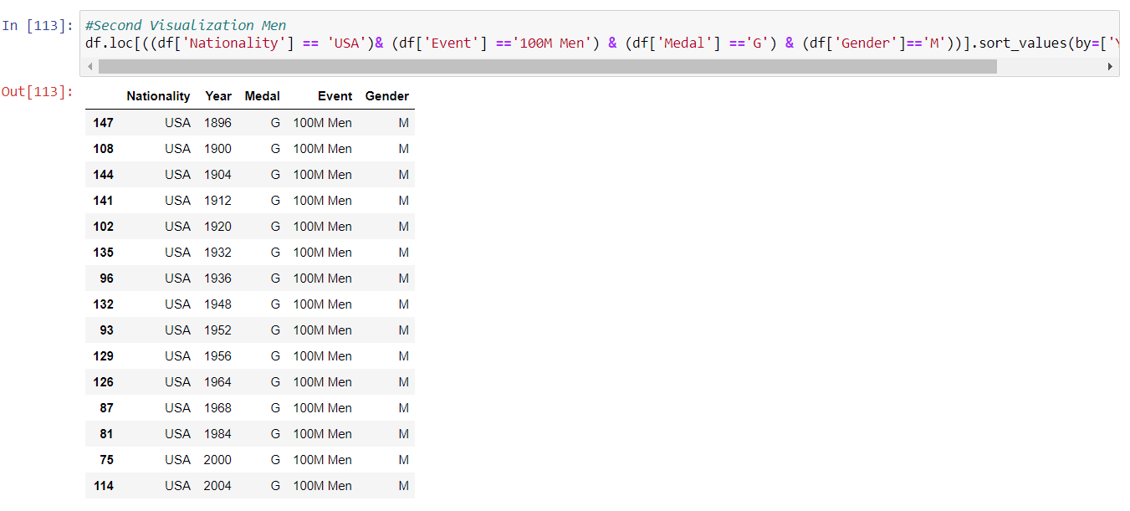
Creating Subsets to prepare for our Viz’s

Slide 7
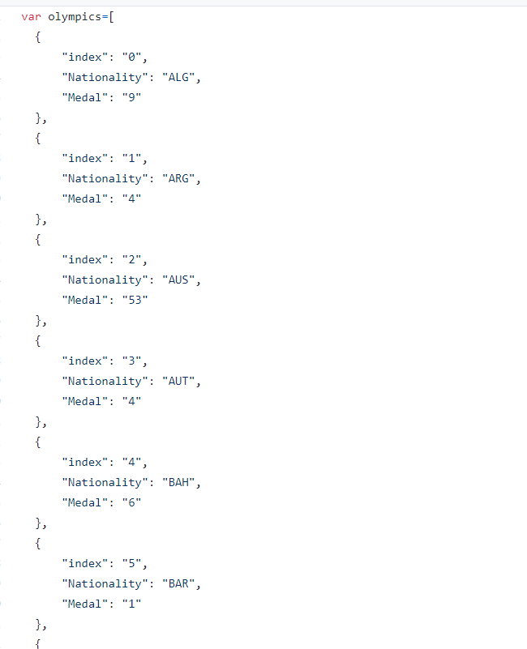
Converting from Csv to Json
For us to use plotly for our visualization the postgres data was saved as Csv, converted to Json, to prepare for Plotly.js

Slide 8
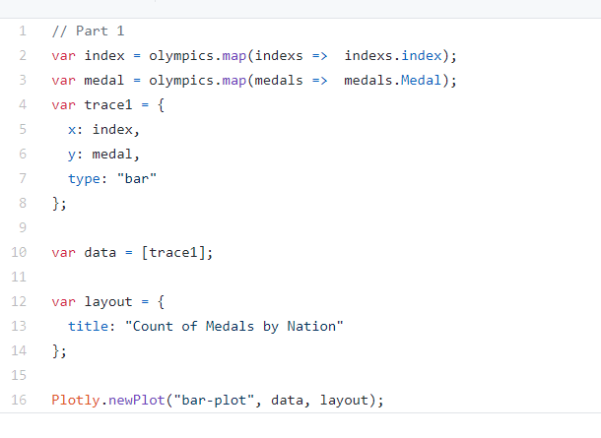
Plotly
Then we wrote the plotly script to visualize our data

Slide 9
Challenges
Flask
Unfortunately on our last day Project workclass we ran out of time with figuring out the Flask Server
Datatypes
We has an issue visualizing the results column dealing with the datatypes between Sql and Python SqlAlchemy

Slide 10
Conclusions

